Slide 1
PSHE
Personal Social Health & Economic Education
Boarshaw Primary School
2020-2021

Slide 2
What is PSHE?
SCARF is a new scheme which we have started to use to teach PSHE this year. It provides a comprehensive spiral curriculum for PSHE education, including mental health and wellbeing.
We have an important part to play in helping kids become well-rounded individuals. Personal, social and health and economic education, or PSHE, aims to give children the knowledge, skills and understanding to lead confident, healthy and independent lives.

Slide 3
Understanding Relationships Education?
We want all children to grow up healthy, happy, safe, and able to manage the challenges and opportunities of modern Britain. From September 2020, all primary age children will be taught Relationships and Health Education.
Relationships Education will put in place the building blocks needed for positive and safe relationships, including with family, friends and online.
Your child will be taught what a relationship is, what friendship is, what family means and who can support them. In an age-appropriate way, we will cover how to treat each other with kindness, consideration and respect.
Health Education aims to give your child the information they need to make good decisions about their own health and wellbeing, to recognise issues in themselves and others, and to seek support as early as possible when issues arise.

Slide 4
What will my child experience?
Your child’s experience of PSHE will be fun, engaging and memorable.
In our school, we will deliver RHE – Relationships and Health Education. The focus of our curriculum will be ensuring children are taught about respect and making positive choices with regards to all aspects of relationships and health. We believe this is crucial in preparing them for the next stage of their lives and education and will support them in making a positive contribution to society and their community.
We want the children in our school:
To feel safe
To be kind
To be proud of their identity
To be heard and be able to share their experiences and knowledge demonstrating good levels of understanding
To have the freedom to ask questions
To be knowledgeable and have a clear understanding of diversity
To feel respected and be able to show respect to others
To be prepared for life and the challenges of living in Modern Britain
To be able to celebrate and understand differences

Slide 5
What will my child learn?
For each year group there are 6 themed units:
Me and my Relationships
Valuing Difference
Keeping myself safe
Rights and Responsibilities
Being My Best
Growing and Changing

Slide 6
Click on the link below to watch a parent video about how to talk to your child about gender.
https://www.youtube.com/watch?v=QgRFVSC9BmU
What will my child learn?
Nursery

Slide 7
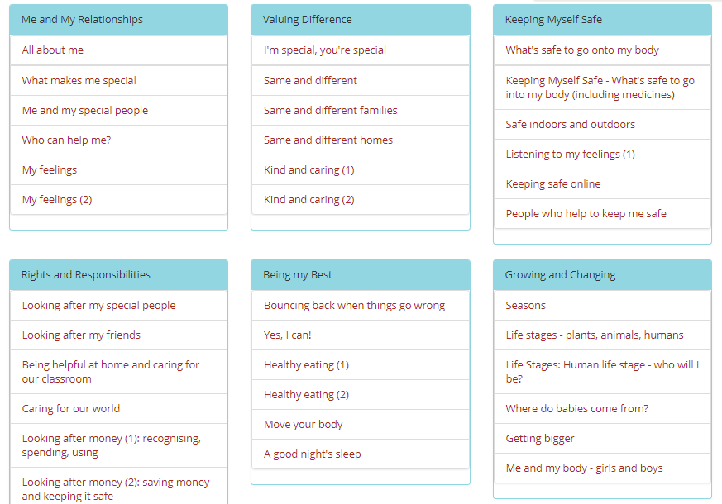
What will my child learn?
Reception

Slide 8
What will my child learn?
Reception

Slide 9
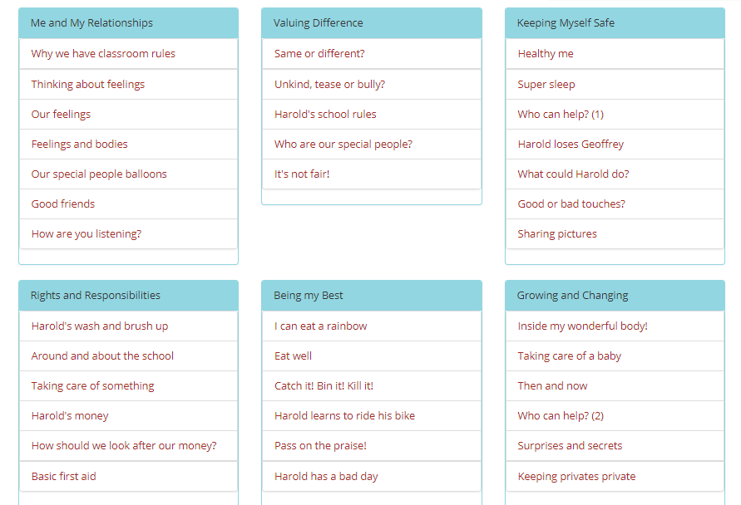
What will my child learn?
Year 1

Slide 10
What will my child learn?
Year 1
Click on the link below to watch the NSPCC Pantosarus video.
https://www.youtube.com/watch?v=-lL07JOGU5o

Slide 11
What will my child learn?
Year 2

Slide 12
What will my child learn?
Year 2

Slide 13
What will my child learn?
Year 3

Slide 14
What will my child learn?
Year 3

Slide 15
What will my child learn?
Year 4

Slide 16
What will my child learn?
Year 4

Slide 17
What will my child learn?
Year 5

Slide 18
What will my child learn?
Year 5

Slide 19
What will my child learn?
Year 6

Slide 20
What will my child learn?
Year 6

Slide 21
When the children reach Year 5 and 6, an outside professional will come in to school to teach elements of the Sex and Relationship Education curriculum. A letter will be sent home to parents prior to this with an overview of what will be taught. There is one element in which a parent has the right to withdraw their child from (sexual intercourse element). Puberty, reproduction and birth are all discussed and are all elements of the Science National Curriculum.
What will my child learn?
SRE
Year 5/6

Slide 22
Please visit our school website for further information.
This presentation has been created to consult with our parents with the development of our PSHE curriculum. We have provided resources to inform parents of what some lessons might look like and to reassure parents in the content that is being taught. Our overall goal in our teaching of PSHE is to keep our children safe and healthy. If you have any questions about anything set out, please email school at:
lthackway@boarshawprimary.co.uk
Thank you

